Slide 1

The new era of SQL Development
sqlcmd
data api builder
azd
Notes:
In this presentation, we will explore the challenges of developing for Azure SQL, and discuss best practices for setting up the correct SQL instance, making connections and queries to the database, and creating infrastructure in the cloud.

Slide 2






mrrobsewell@outlook.com
Rob Sewell
He/Him
I was a SQL Server DBA with a passion for Powershell, Azure, Automation, and SQL (PaaS geddit?) (And a sense of humour (and a habit for writing inside braces)). Now I just help other people with those (not the braces bit).
SEWELLS CONSULTING LTD
Beard Twizzler
MICROSOFT MVP
DATA PLATFORM 2020 - 2024
Azure 2017 - 2024
INTERESTS
cycling, automation, community
robsewell.com

Slide 3

CHALLENGES

Slide 4
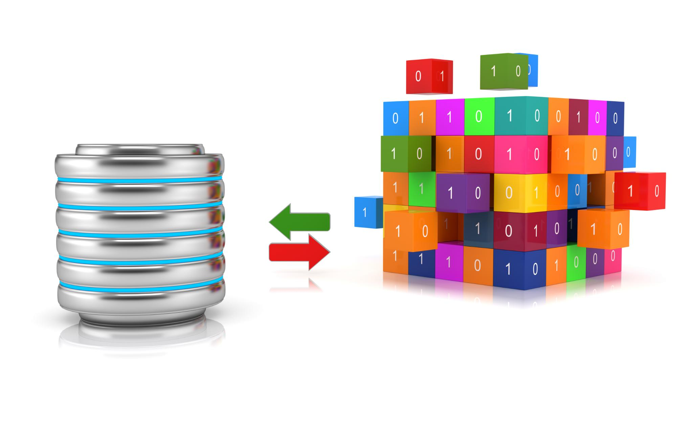
Setting Up the Correct SQL Instance and Database
Notes:
Setting up the correct SQL instance can be a challenge, but there are a few tools and approaches that can make the process easier. In this section, we will explore two options: using SQLCMD and using Data API Builder.

Slide 5

All the code that is needed time and time again

Slide 6

Deploying to the cloud to develop

Slide 7

Setting Up the Correct SQL Instance
Old Name - New CLI
why you should look at sqlcmd

Slide 8

GO-SQLCMD
aka.ms/sqlcmd
forked from
go-msqldb
written in Go
compiles into one exe
cross-platform
cross architecture
Shiny and New

Slide 9



Slide 10
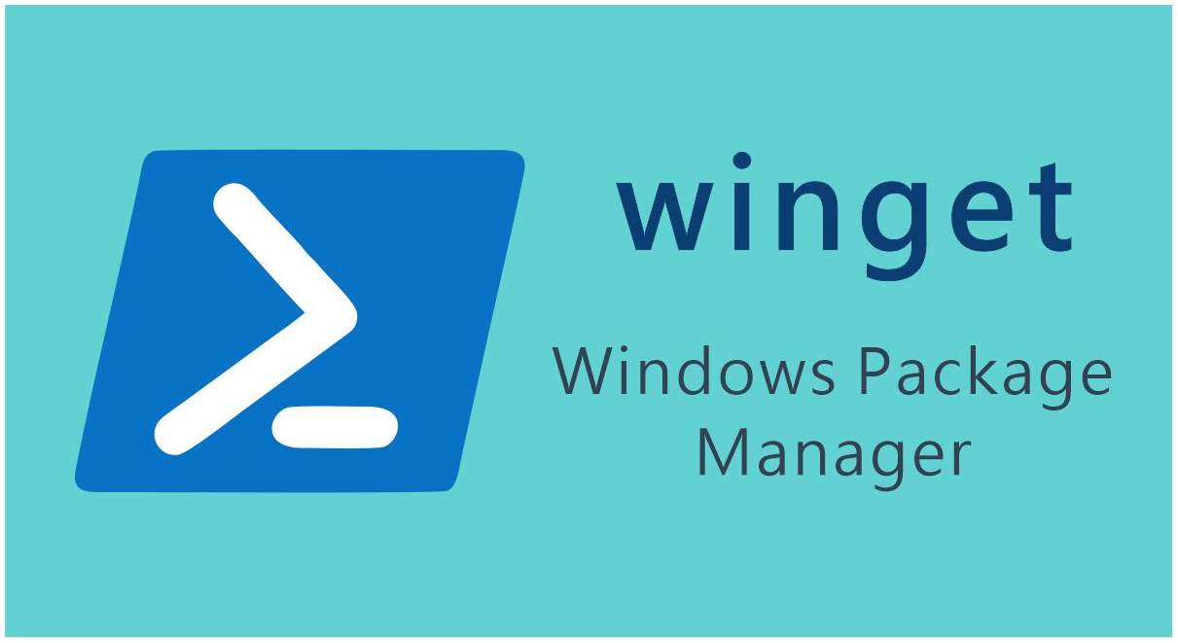

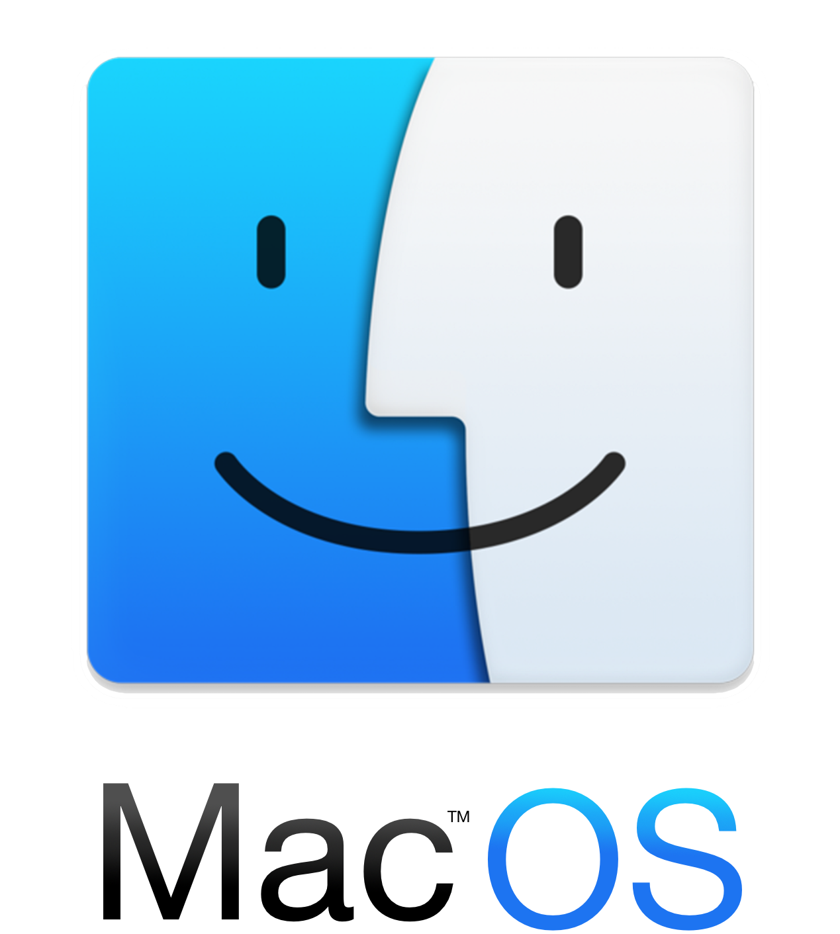

installation
winget install sqlcmd
choco install sqlcmd
brew install sqlcmd
Linux
apt-get install sqlcmd yum install sqlcmd
All major package managers supported

Slide 11


Slide 12

Demo
Time

Slide 13
All the code that is needed time and time again

Slide 14
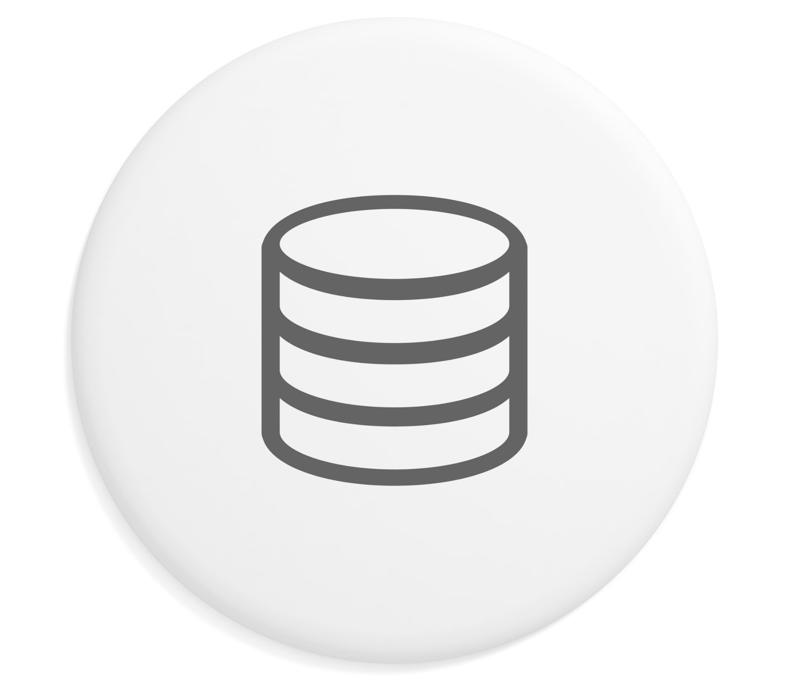
Using Data API Builder
Data API Builder simplifies the process of creating and deploying APIs for databases. It allows you to create RESTful APIs for databases with minimal coding.
Notes:
Data API Builder is a tool that simplifies the process of creating and deploying APIs for databases. It allows you to create RESTful APIs for SQL Server databases with minimal coding. We will explore how to use Data API Builder to set up the correct SQL instance.

Slide 15
Using Data API Builder
Data API Builder simplifies the process of creating and deploying APIs for databases. It allows you to create RESTful APIs for databases with minimal coding.
Notes:
Data API Builder is a tool that simplifies the process of creating and deploying APIs for databases. It allows you to create RESTful APIs for SQL Server databases with minimal coding. We will explore how to use Data API Builder to set up the correct SQL instance.

Slide 16
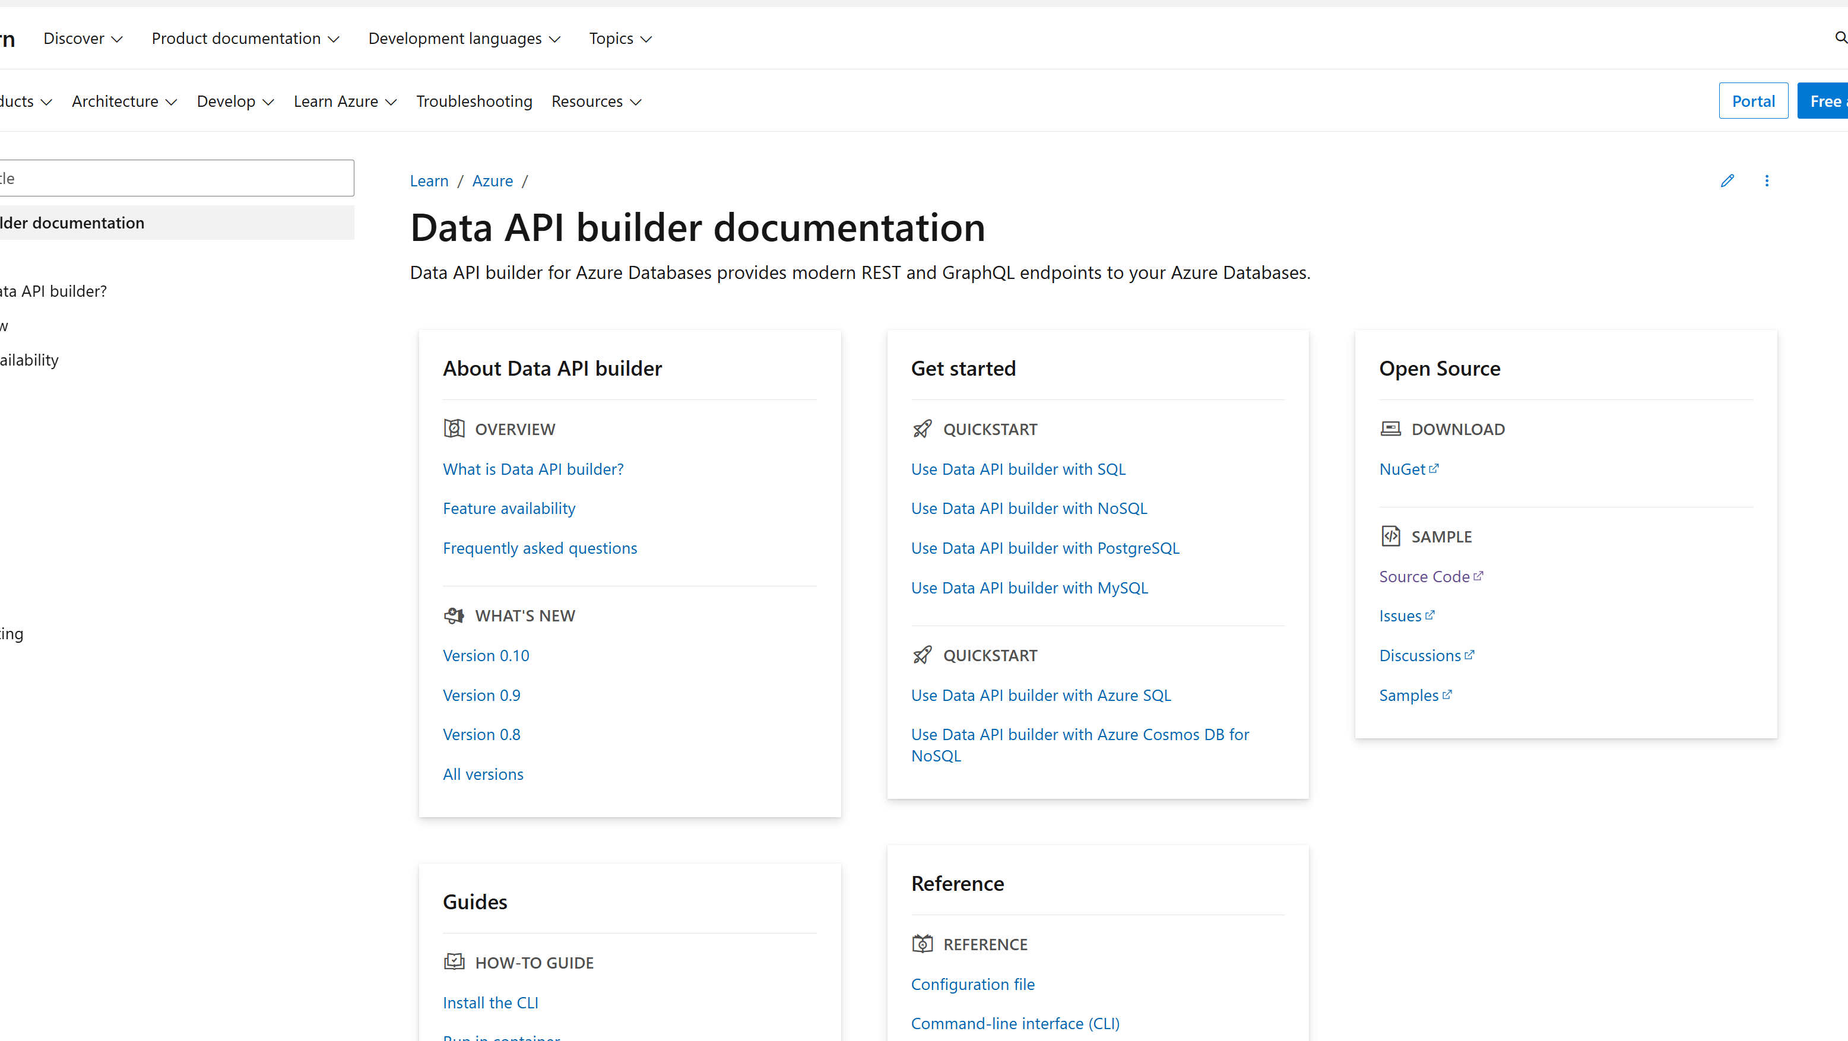
learn.microsoft.com/en-us/azure/data-api-builder

Slide 17
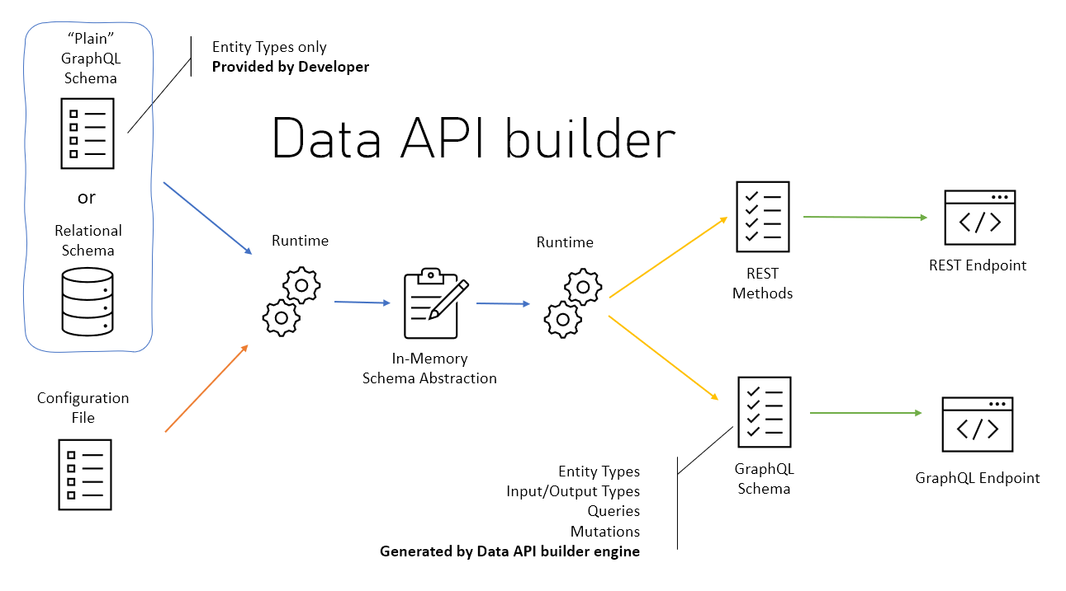

Slide 18

Demo
Time

Slide 19
Deploying to the cloud to develop

Slide 20

Azure Developer CLI (azd)
Streamline Azure resource management with azd
Notes:
Azure Developer CLI (azd) is a command-line interface for managing Azure resources. In this presentation, we will explore the capabilities of azd, how to install and configure it, and how to use its commands for various use cases.

Slide 21

Working with Azure Developer CLI (azd)
winget install microsoft.azd
choco install azd
Installation and Configuration
Before you can start using azd commands, you need to install and configure the CLI.
curl -fsSL https://aka.ms/install-azd.sh | bash
brew tap azure/azd && brew install azd
Notes:
Once you have installed and configured azd, you can start using its commands to manage Azure resources. We will walk you through various use cases to demonstrate how to use azd commands.

Slide 22
Working with Azure Developer CLI (azd)
choco install azd
Installation and Configuration
Before you can start using azd commands, you need to install and configure the CLI.
winget install microsoft.azd
curl -fsSL https://aka.ms/install-azd.sh | bash
brew tap azure/azd && brew install azd
Notes:
Once you have installed and configured azd, you can start using its commands to manage Azure resources. We will walk you through various use cases to demonstrate how to use azd commands.

Slide 23
Working with Azure Developer CLI (azd)
Installation and Configuration
Before you can start using azd commands, you need to install and configure the CLI.
choco install azd
winget install microsoft.azd
curl -fsSL https://aka.ms/install-azd.sh | bash
brew tap azure/azd && brew install azd
Notes:
Once you have installed and configured azd, you can start using its commands to manage Azure resources. We will walk you through various use cases to demonstrate how to use azd commands.

Slide 24
Working with Azure Developer CLI (azd)
curl -fsSL https://aka.ms/install-azd.sh | bash
Installation and Configuration
Before you can start using azd commands, you need to install and configure the CLI.
brew tap azure/azd && brew install azd
Notes:
Once you have installed and configured azd, you can start using its commands to manage Azure resources. We will walk you through various use cases to demonstrate how to use azd commands.

Slide 25
Working with Azure Developer CLI (azd)
brew tap azure/azd && brew install azd
Installation and Configuration
Before you can start using azd commands, you need to install and configure the CLI.
Notes:
Once you have installed and configured azd, you can start using its commands to manage Azure resources. We will walk you through various use cases to demonstrate how to use azd commands.

Slide 26
Working with Azure Developer CLI (azd)
Dev Container ☺
{
"name": "Azure Developer CLI",
"image": "mcr.microsoft.com/devcontainers/python:3.10-bullseye",
"features": {
// See https://containers.dev/features for list of features
"ghcr.io/devcontainers/features/docker-in-docker:2": {
},
"ghcr.io/azure/azure-dev/azd:latest": {}
}
// Rest of file omitted...
}
Notes:
Once you have installed and configured azd, you can start using its commands to manage Azure resources. We will walk you through various use cases to demonstrate how to use azd commands.

Slide 27
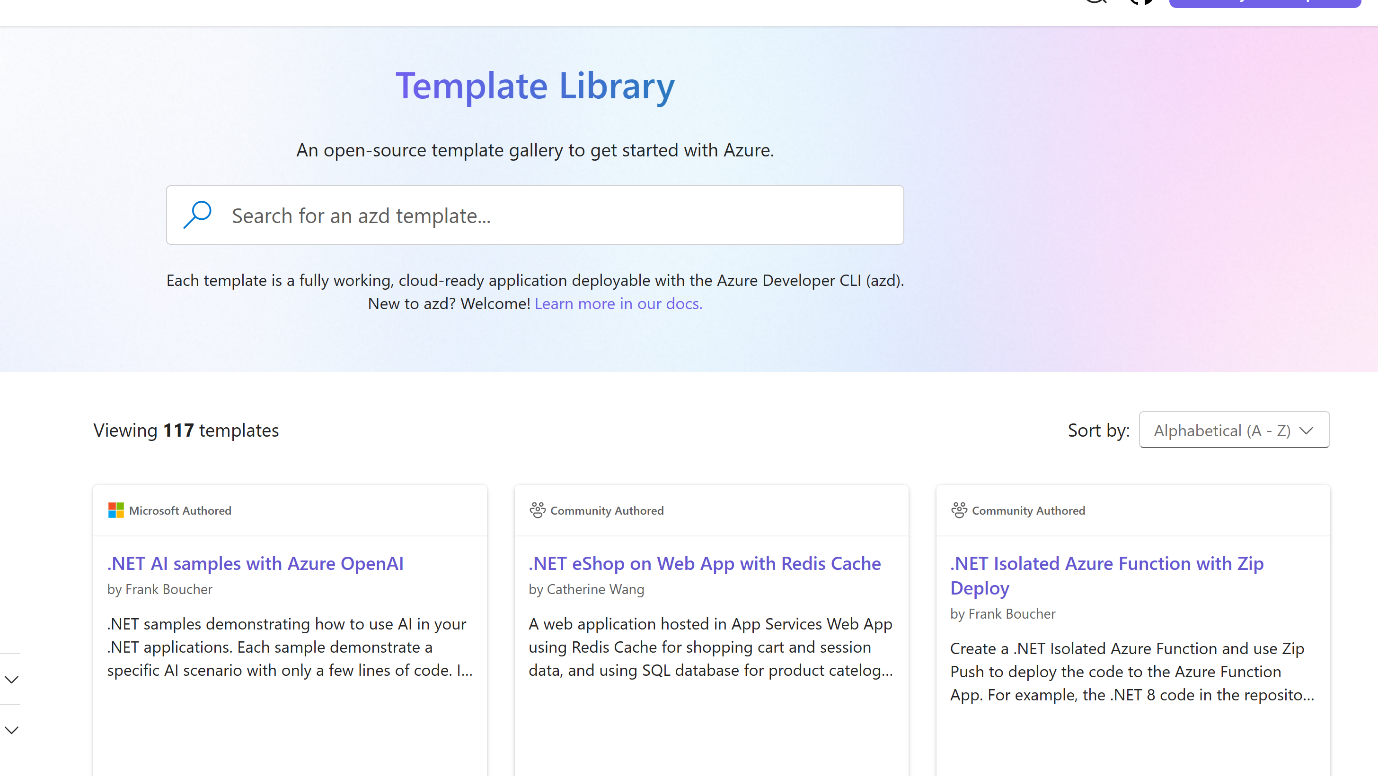
https://azure.github.io/awesome-azd/

Slide 28

Demo
Time

Slide 29




Notes:
Feedback – use this link

